Slide 1










Technocrats
TEAM PROJECT
EDUBUZZ
BUILDING A BETTER TOMORROW
Presented by Group 2
Cohort 2.0 Software Development

Slide 2


Hello Everyone!
We are Group 2.
Technocrats
TEAM PROJECT

Slide 3

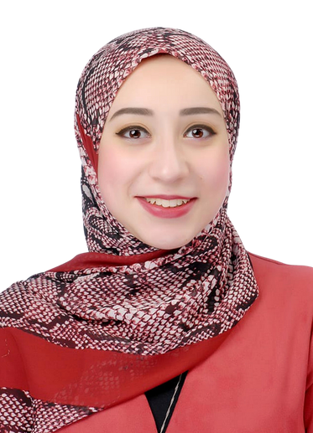
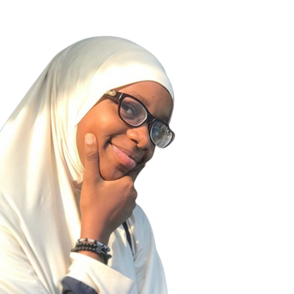
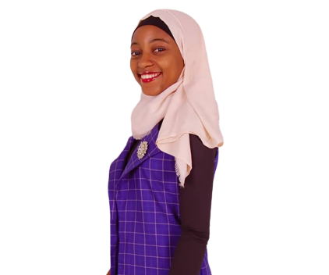



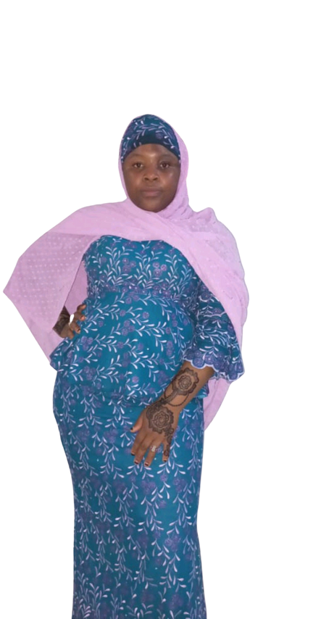
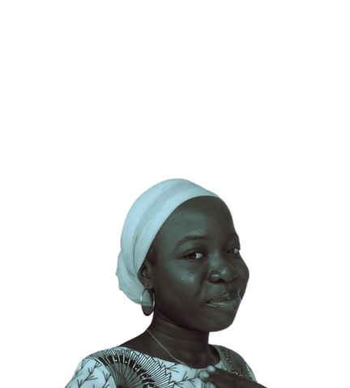
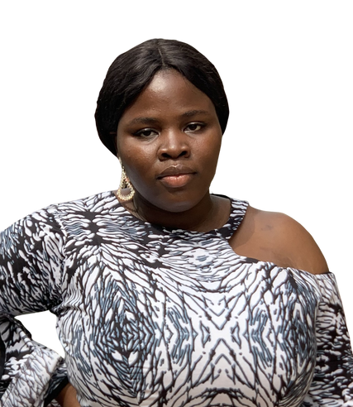

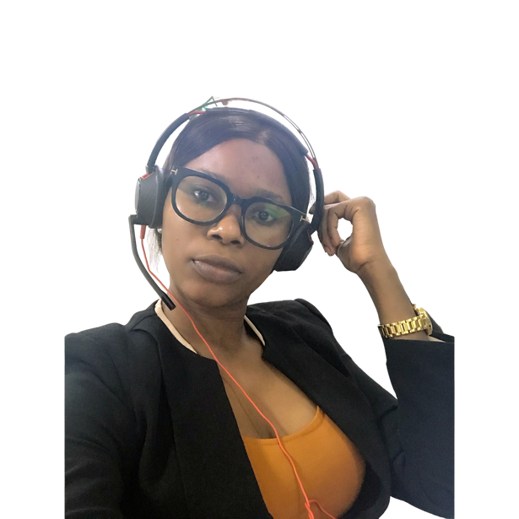
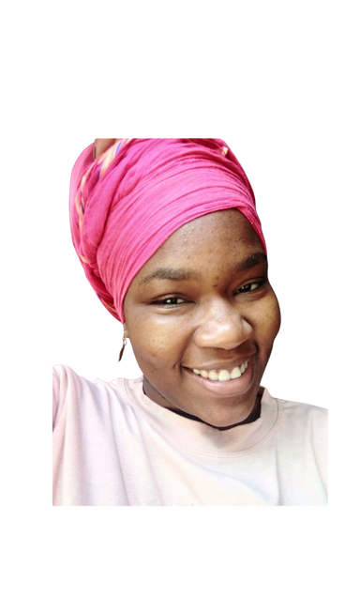

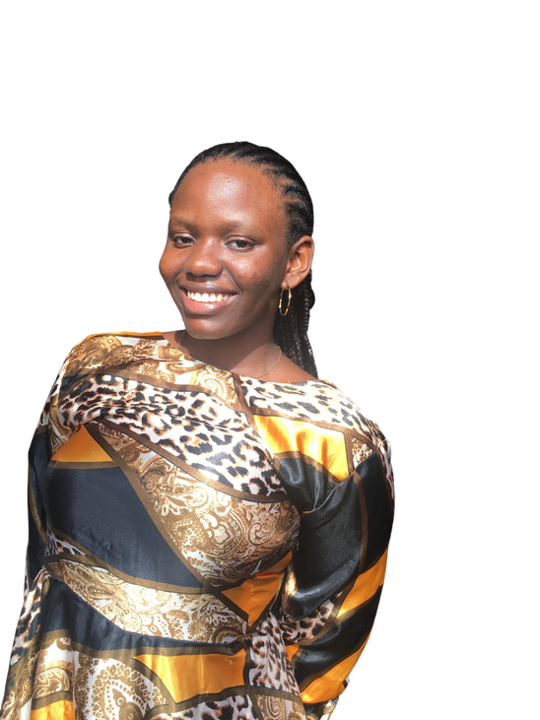


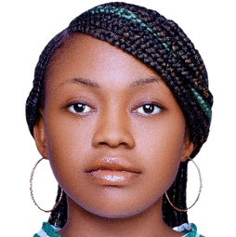
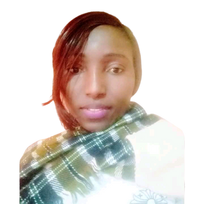

Meet The Group
Technocrats
TEAM PROJECT
sophieblarke@gmail.com
rbeltagy@pis.edu.eg
abeedahalabi@gmail.com
sannighaneeyhat@gmail.com
Edelasi704@gmail.com
cynthiaamaran@outlook.com
yusufaishat45@gmail.com
Halimalyh13@gmail.com
amakundit@gmail.com
royalnma4@gmail.com
orjivictoria884@gmail.com
Sophiat Akintola
Reham Beltagy
Abeedah Alabi
Ganiyat Sanni
Edlawit Mekonnen
Cynthia Nnadiukwu
Aishat Yusuf
Halima Hassan
Amakundi Timothy
Royal Mathias
Victoria Orji
Team Leader
Team Lead Assistant
Team Member
Team Member
Team Member
Team Member
Team Member
Team Member
Team Member
Team Member
Team Member
minatisgreat
hawacoutinho17
ulanandrew20
nwanneka.udensi.un
ewomaluckyomogbolu
estheradewumi829
osadumenkeonye
dorathyjikop
elogho37@gmail.com
itemabasietteumoh
christalchiamaka
Christanahagbekeye
Aminat
Hawa Coutinho
Ulan Andrew
Nwanneka Udensi
Ewoma lucky
Adewumi Esther
Rita Osadume
Dorathy Anthony
Eloghosa
ItemAbasi
Chiamaka
Christianah
Team Member
Team Member
Team Member
Team Member
Team Member
Team Member
Team Member
Team Member
Team Member
Team Member
Team Member
Team Member

Slide 4



•About EduBuzz
•SDGs Considered/Involved
•Problem
Technocrats
TEAM PROJECT
PROJECT'S OUTLINE
•Vision
•Mission
•The Mandate
•Our Solution Model
•A Snippet
•References

Slide 5

About EduBuzz
EduBuzz is a non-governmental female organisation that strives to create lasting solutions to improve education by bridging the educational gap in Africa through the provision of funds by donors and other organizations.
Our goal is to ensure that all girls and boys complete free primary and secondary schooling by 2030. We are also serving teachers in our funding plan. In line with SDG4, we provide donations of school materials and scholarships for children and welfare packages to teachers to improve education quality and help students access services and interventions to lower barriers to school attendance.
Technocrats
TEAM PROJECT

Slide 6



Technocrats
TEAM PROJECT
SDGs considered/Involved
4
8
high-quality education
decent work and economic growth
It’s excellent for capturing audiences beyond a one-time event.
10
11
reduced inequalities
sustainable cities and communities

Slide 7



Technocrats
TEAM PROJECT
Problem
General Overview
01
02
03
The rates of education exclusion in
Sub-Saharan Africa are alarming: over 20% for children aged 6–11, over 30% for ages 12–14, and about 60% for ages 15–17
617 million children around the world fail to acquire minimum literacy and math knowledge due to a lack of qualified teachers and inadequate learning materials
the exclusion rate of the girl child from receiving education at an early age is 23% to 19% for boys, and 36% compared to 32% for boys, in adolescence

Slide 8




Vision
Providing about 50,000 African boys and girls with free quality education, bridging the educational gap and making education more accessible in Africa.

Slide 9


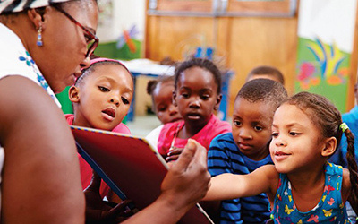

Mission
1) Provision of scholarships, sponsorship, and welfare packages to students and teachers, in addition to enhancing individual well-being.
2) Providing the support and means needed to help Africa's next generation attain primary and secondary education.
3) Working with organizations and communities to implement educational programs.
4) Creating a donation platform for sponsors and organizations.

Slide 10

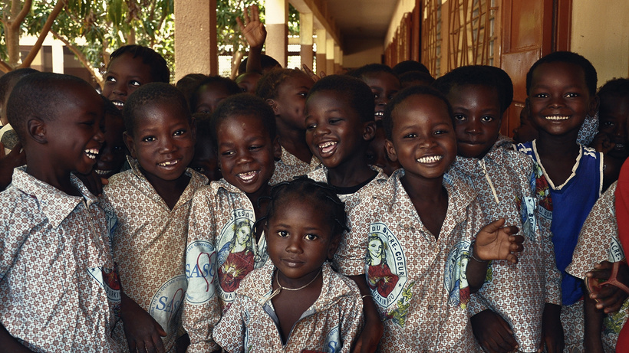

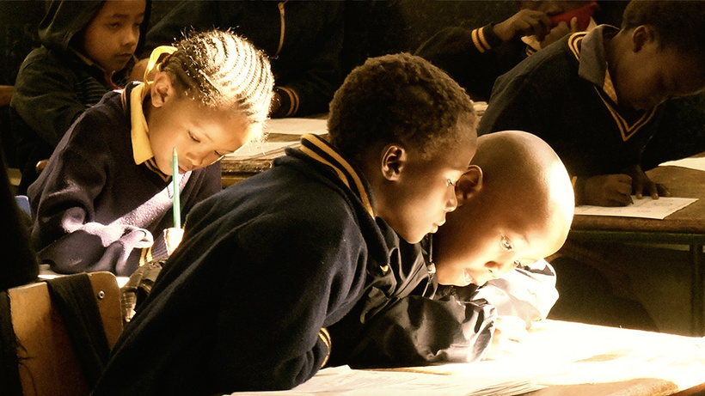



THE MANDATE
Focus One:
We seek to provide a means whereby children in primary and secondary schools get a hitch-free education at no cost. This is done through the provision of educational materials needed for all-round study.
Focus Two:
This also seeks to help provide welfare packages to teachers in order to improve the quality of the dissemination of educational services to students.

Slide 11


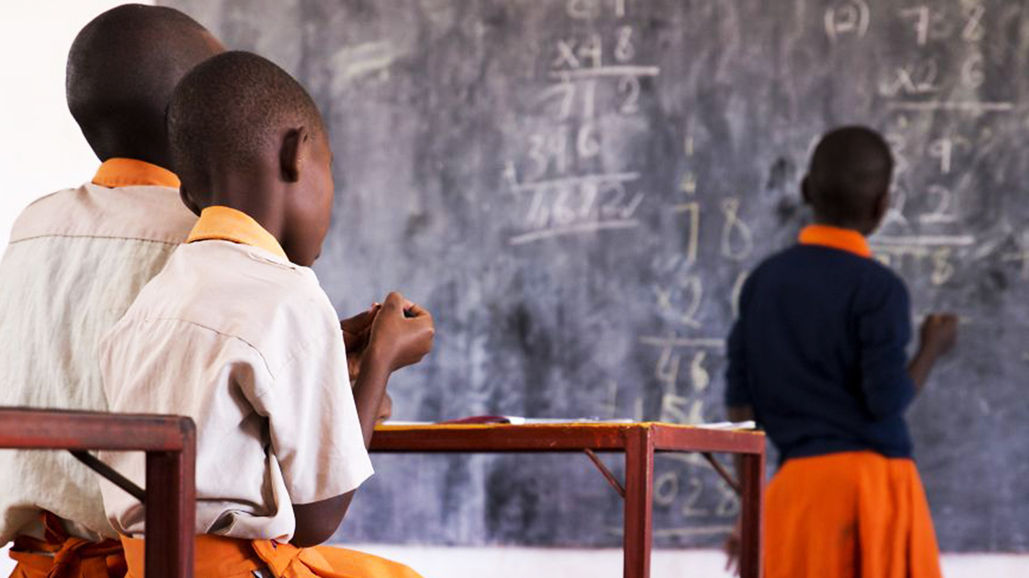

WHAT WE WANT TO ACHIEVE
OUR SOLUTION MODEL
1) Cooperation with other organizations for teacher training to increase their qualifications.
2)Upgrading educational facilities to be child, gender, and disability sensitive will provide a safe environment for learning.
3)Awareness, especially in rural areas, of the importance of early education and girl child education.
4)Provision of free education and support for children from poor families.
Technocrats
TEAM PROJECT

Slide 12
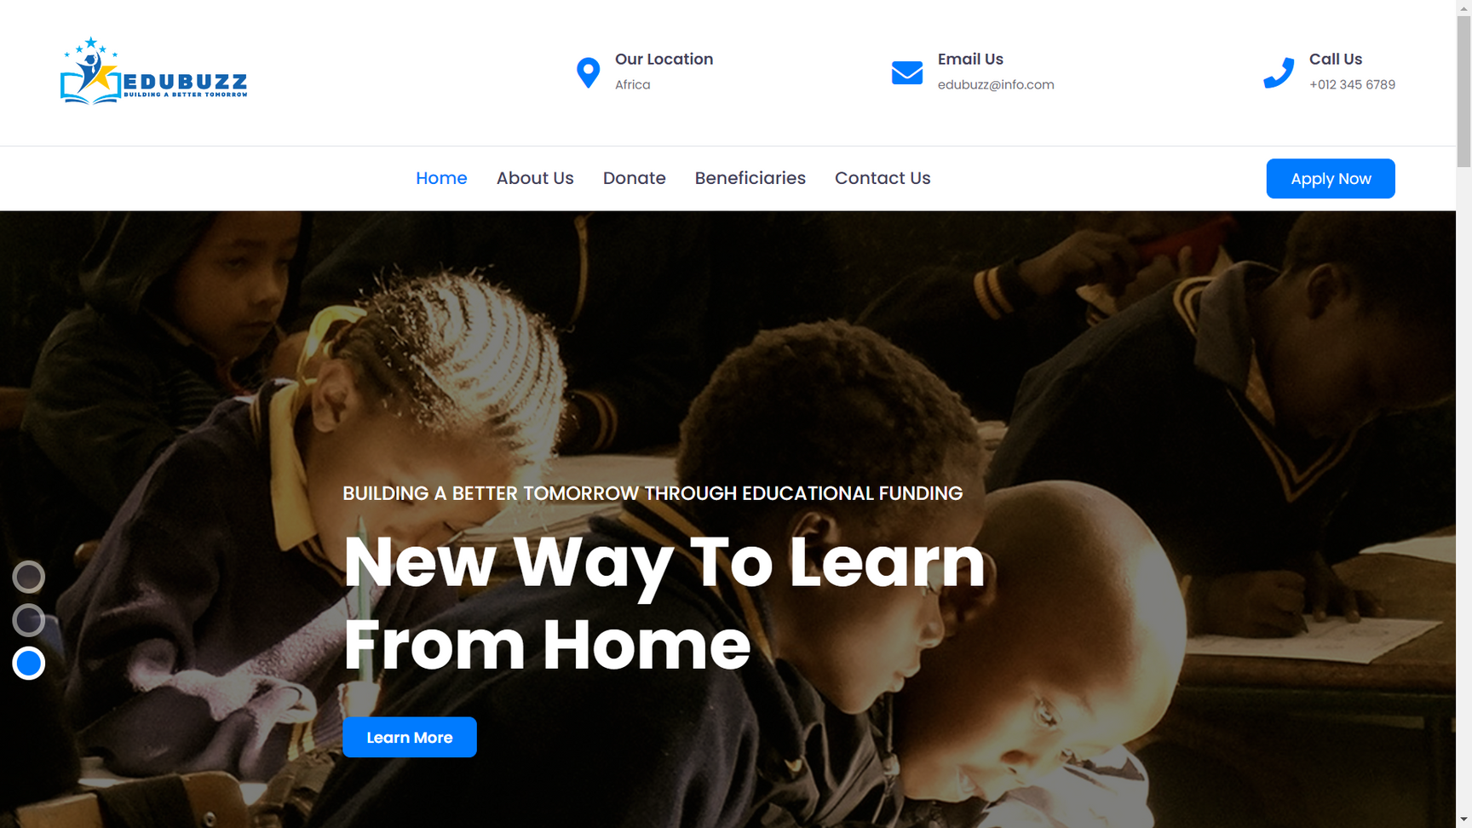
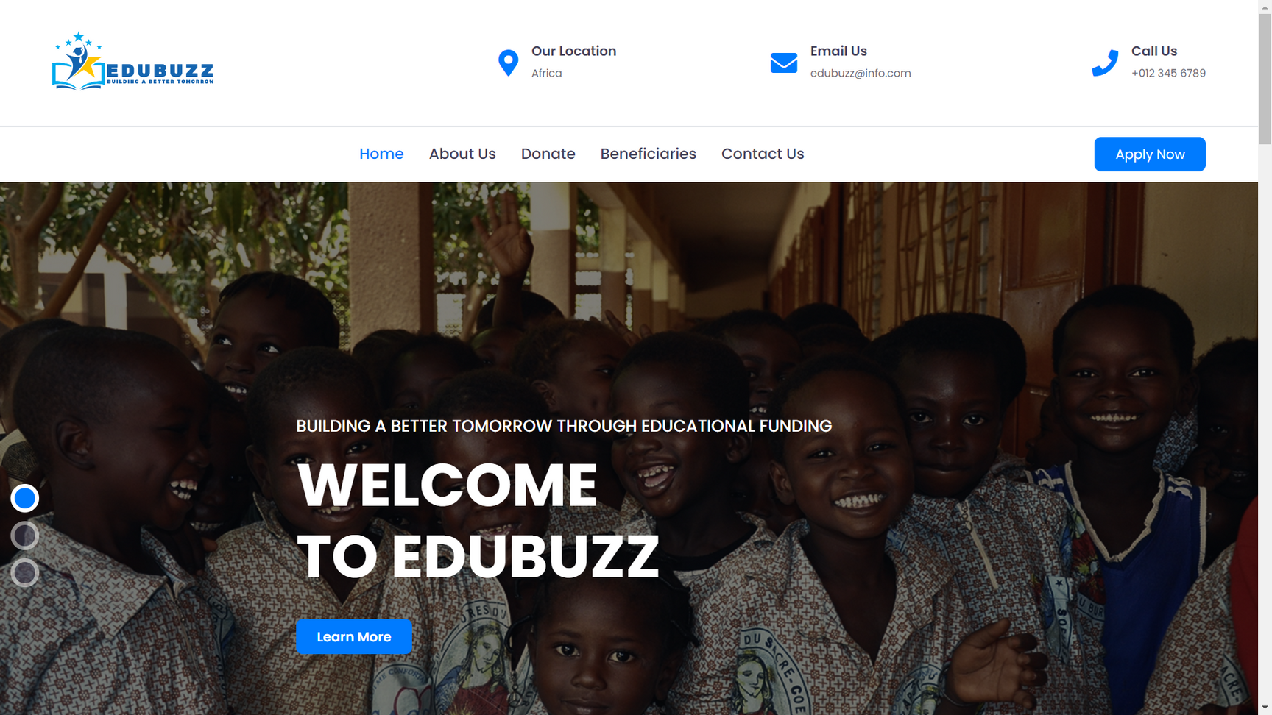
PLATFORM'S LANDING PAGE
(A SNIPPET)
Technocrats
TEAM PROJECT

Slide 13

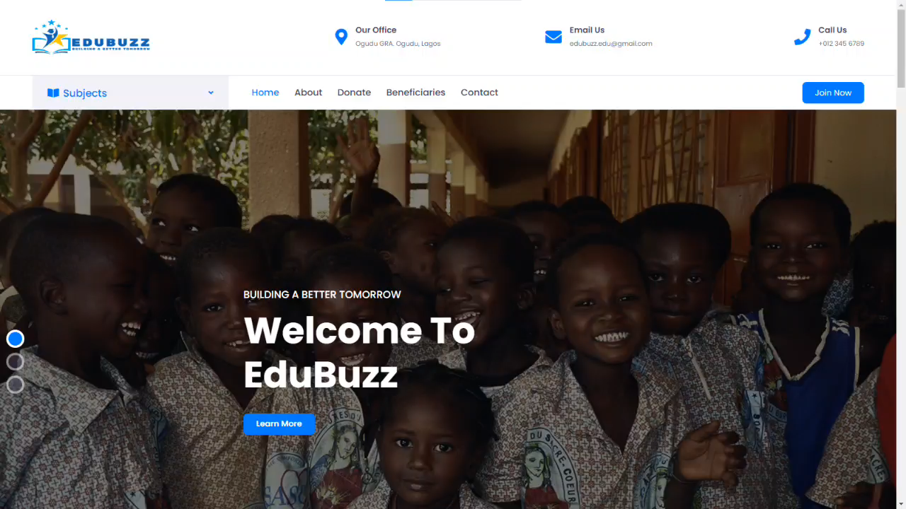

Technocrats
TEAM PROJECT
Website
Live Demo
EDUBUZZ
BUILDING A BETTER TOMORROW

Slide 14
Technocrats
TEAM PROJECT
UNESCO (2016). Education in Africa | UNESCO UIS. [online] Unesco.org.
Consulting, W. (n.d.). SDG 4 and Targets. [online] Global Campaign for Education.
ReliefWeb. (n.d.). Experts say more quality education needed in Africa - World. [online]
Educate Every Child on the Planet: The World Top 20 Project. (n.d.). The Global Movement for Our Children’s Future - World Top 20 Project.
References
EDUBUZZ
BUILDING A BETTER TOMORROW

Slide 15


Thank you!
Do you have any questions for us?
Technocrats
TEAM PROJECT
EDUBUZZ
BUILDING A BETTER TOMORROW

